Slide 1
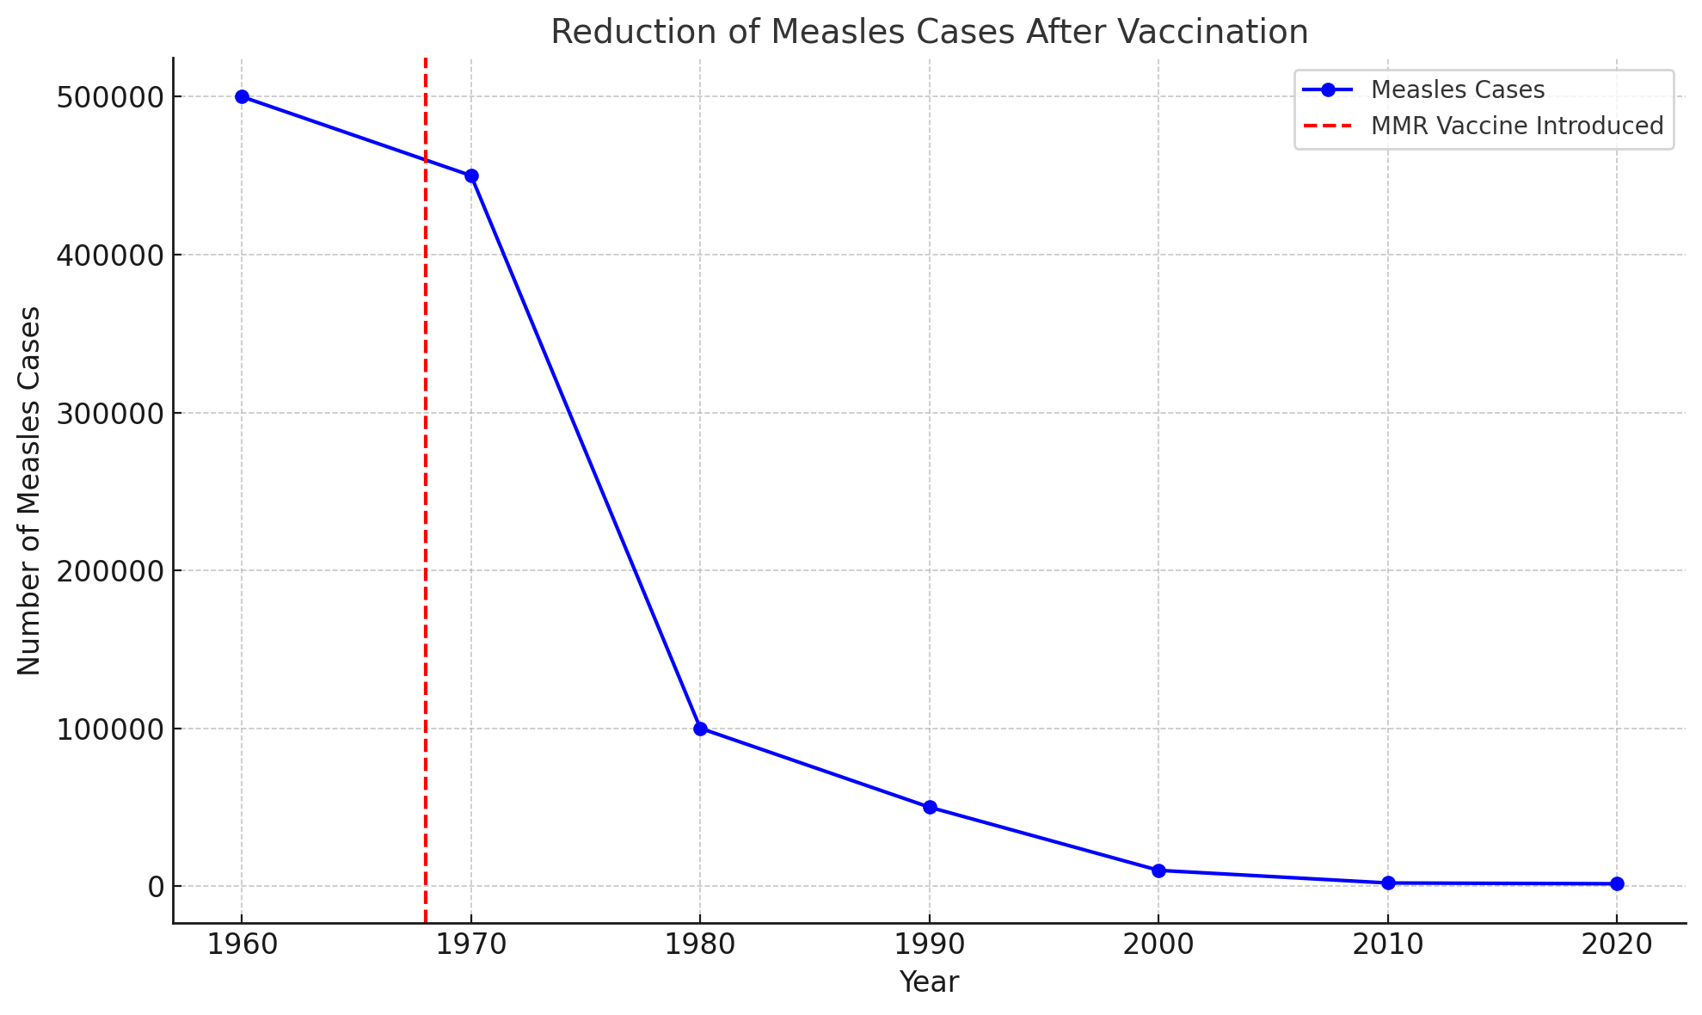
Notes:
Spalničky: Do 70. let hrozbou zejména pro malé děti a osoby s oslabeným imunitním systémem. Před zavedením očkování byly spalničky běžným a smrtícím onemocněním, které postihovalo miliony lidí po celém světě. Díky rozšířenému očkování pomocí MMR vakcíny (vakcína proti spalničkám, příušnicím a zarděnkám) se však výskyt spalniček dramaticky snížil.
Medicínsky je vakcína MMR skvělým příkladem toho, jak fungují evidence-based metody:
Phase I and II Trials: These early trials established safety, determining the right dosages and potential side effects. –
Phase III Trials: Large-scale trials tested the vaccine’s efficacy in preventing measles, mumps, and rubella. These trials involved thousands of participants across different regions and populations to ensure that the vaccine worked broadly.
Purpose: The main goal of Phase 1 is to test the vaccine for safety in a small group of healthy volunteers (typically 20-100 people). Researchers monitor the participants for side effects and adverse reactions.
Dose-Finding: Phase 1 trials often focus on identifying the optimal dose by testing different levels of the vaccine. The immune response generated by the vaccine is also observed, but efficacy is not the main focus at this stage.
Phase 2 expands on Phase 1 by testing the vaccine in a larger group of participants (usually 100-300 people), with more focus on finding the right dosage, continuing to monitor safety, and observing the immune response to the vaccine.
Randomized Controlled Design: Phase 3 trials are typically randomized controlled trials (RCTs), which means participants are randomly assigned to either the vaccine group or a control group. This design is essential for eliminating bias and ensuring that the results can be attributed to the vaccine, not other factors.
Control Group: In vaccine trials, the control group usually receives either:
A placebo (a harmless substance that mimics the vaccine but has no active ingredients), or
An alternative vaccine (to compare the new vaccine to an already existing one).
After the introduction of the MMR vaccine, the incidence of these diseases dropped by over 90% in vaccinated populations. For example, in the UK, the introduction of the MMR vaccine in 1988 led to a significant reduction in cases of measles, mumps, and rubella within a few years.

Slide 2
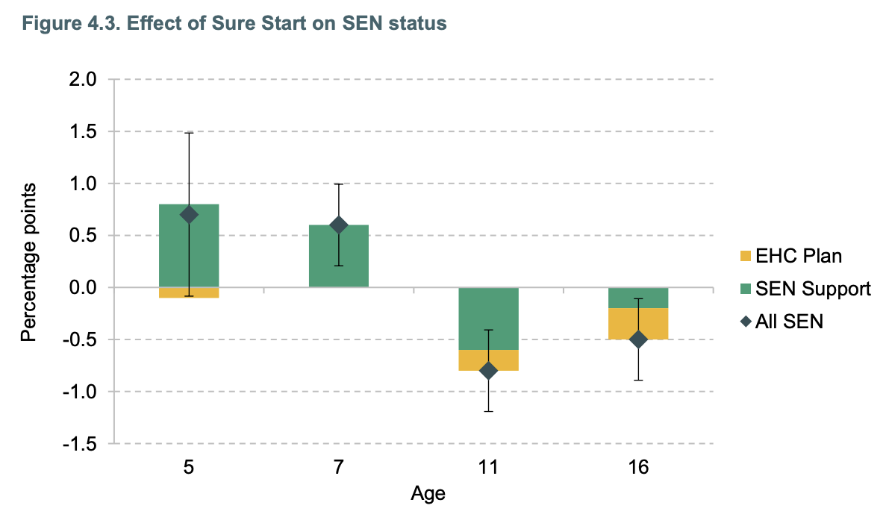
Víme, že prevence funguje i ve sociálních službách/vzdělávání:
Sure Start (Velká Británie)
Carneiro et al. (2024)
Notes:
Introduced in 1999, Sure Start was the first large government initiative to provide holistic support to families with children under the age of 5 in England. The policy introduced a network of local ‘one-stop shops’, which brought together a range of services to support local families with the aim of enhancing the development and life chances of children under 5. These services included health services, parenting support, early learning and childcare, and parental employment support.
Health Services:
Antenatal (prenatal) and postnatal care services.
Well-baby clinics and vaccinations.
Speech and language therapy, dental checkups, and nutritional advice.
Parenting Support:
Parenting classes, including advice on child development, behavior management, and parenting skills.
One-on-one sessions for parents dealing with specific challenges, such as financial difficulties or mental health concerns.
Employment and Financial Advice:
Job training programs or workshops on improving employability, helping parents return to work, and gaining new skills.
Support services for families accessing benefits, managing debts, or improving their housing situation.
Social Services Referrals:
Od roku 2010 se Sure start program postupně zužoval – zhruba o ⅔ skrz outsourcing a soukromé poskytovatele. Nyní je program na mírném vzestupu skrze koncept Family Hubs (300 mil. liber od roku 2022 do roku 2025).
At Age 5: There is a slight positive effect (around 0.5 percentage points) on SEN identification, with most of the increase due to children receiving SEN Support. This suggests that Sure Start had an early influence in recognizing and supporting children with mild to moderate special needs.
At Age 7: The positive impact is slightly lower than at age 5, but children are still more likely to receive SEN Support than a formal EHC plan. The overall increase in SEN status (both EHC and SEN Support combined) is around 0.3 to 0.5 percentage points.
At Age 11: The effect reverses, with a negative impact (around -0.5 percentage points) on SEN status. This indicates that fewer children were identified as having special educational needs by age 11 in Sure Start areas compared to the control group. This could suggest that early interventions helped to reduce the need for SEN identification later on.
At Age 16: The negative effect on SEN status remains but is smaller, around -0.3 percentage points. Again, this implies that fewer children required SEN support or an EHC plan at this stage, possibly due to the long-term benefits of Sure Start interventions.

Slide 3
Dopad na děti: Od fyzického zdraví po podíl dětí se speciálními vzdělávacími potřebami
Dopad na dospělé dětem nejblíže – rodiče
Notes:
Efekty lze pozorovat v konkrétních doménách:
Menší problémy s chováním u chlapců: Research has shown that Sure Start programs led to a reduction in behavioral problems in children, particularly boys
Zlepšení

Slide 4
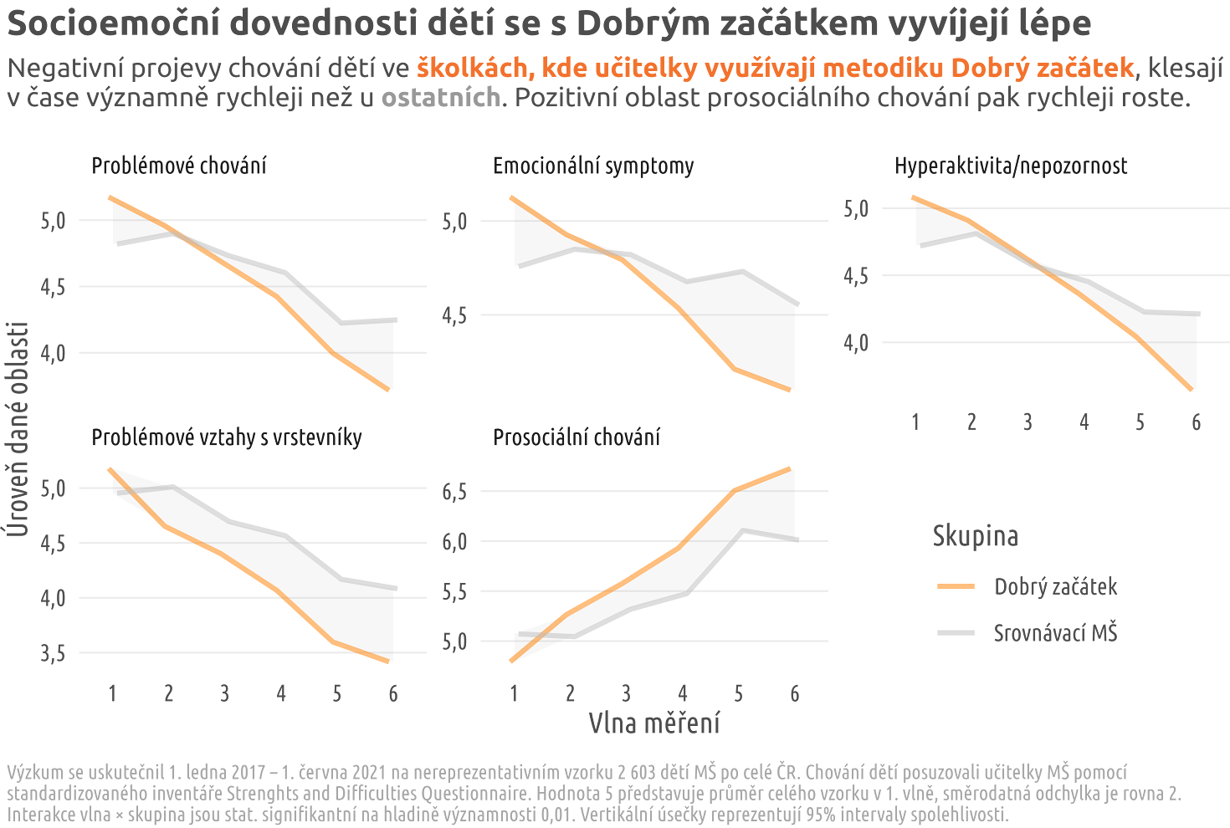
Notes:
Téměř petiletý výzkum 2 603 dětí po celé ČR. 6 vln měření. Zásadní rozdíly až mezi 5 až 6 vlnou měření.
Systémovost: Kontinuální podpora. Fungující projekty podpořit raději – inovace jsou shit.

Slide 5
Evidence-based metody jsou jediným relevantním způsobem jak zajistit účinnost programů za několika předpokladů
Notes:
Rigorózní testování nelze nahradit žádnou intuicí
Programs that are not based on evidence can expose participants to risks, inefficiency, or unintended negative consequences
Evidence-based methods ensure that resources—whether financial, human, or time-related—are used optimally. Evidence-based programs can provide clear cost-benefit analysis
Evidence-based programs are built on clearly defined methodologies and are subject to peer review and replication. This provides accountability and transparency

Slide 6
Požadavek na srovnávací skupinu
Dostatečně dlouhá doba měření
Metodologicky adekvátní přístupy
Nutnost systémové podpory a financování
Notes:
1 In randomized controlled trials (RCTs), a control group that does not receive the intervention allows researchers to measure the difference in outcomes between those who did and did not participate in the program, ensuring that the program itself caused the observed changes
2 A sufficient measurement period is required to capture the long-term effects of an intervention, especially when targeting areas like education, behavior change, or health outcomes. Short-term measurements can be misleading, as immediate results may not reflect sustained or real impacts
3 While rigorous methodology is essential, for short-term interventions, such as one-year programs, using a full-scale randomized controlled trial (RCT) design may be unnecessary or even impractical.
Využívání dostatečně dlouhé doby měření nebo srovnávací skupiny ale vyžaduje, abychom systémově a dlouhodobě podporovali programy a měření na podporu rozvoje socioemočních dovedností dětí.

