Slide 1
Notes:
My story, how I came to spend time in five education systems.

Slide 2
Features of high-performing curricula
Focused
and
Coherent

Slide 3
Focus
“The most significant difference I find is the depth of material covered. In Canada they do a little bit of everything, and they do it really fast, before you really get the essence of that part, and then they jump into something else. Whereas in China they go on about some knowledge for quite a long time, maybe several weeks before they move to the next topic, so you get a lot of practice, and you really know it.”
Sophie
Notes:
It is clear what students have to study, and there is not too much of it.

Slide 4
Focus: fewer topics in greater depth
Fewer topics are taught each year in top-performing countries.
E.g. 10 mathematics topics in 8th grade rather than 30.
Notes:
Your curriculum is 900 pages long.
15 across 3 years.

Slide 5
This allows for all children to access the curriculum and move along together
The vast majority of pupils’ progress through the curriculum at the same pace.
Academically weaker pupils are supported to reach the standard they need to progress through the curriculum.
More able pupils are encouraged to explore the content in greater depth and/or breadth.
Children are less likely to be left behind.
Notes:
This is where clarity is also important (which your curriculum appears to do a good job of). What is the standard that children need to progress to the next stage of the curriculum? This relates to the next feature of HP systems

Slide 6
It also leaves space for the development of 21st Century skills

Slide 7
Features of high-performing curricula
Focused Focusing on fewer topics, clearly specified, allowing for greater depth of study and space for application of knowledge.
Coherent

Slide 8
Coherent
Curricula are coherent
“if they are articulated over time as a sequence of topics and performances that are logical and reflect, where appropriate, the sequential or hierarchical nature of the disciplinary content from which the subject matter derives”
(Schmidt et al., 2002)

Slide 9
In other words…
Knowledge and skills carefully sequenced in a so that at every stage, students have the necessary understanding or ability that they need to access the new learning.
E.g. Understanding fractions before adding fractions.
E.g. Basic introduction to democracy through a simple context, before studying the workings of the National Council.
Notes:
(Your Science curriculum does this well, though possibly too much content)

Slide 10
Why might coherence be important?
Because according to cognitive science, children (and adults) learn by connecting new learning with something they already know.
If they don’t have any existing knowledge or experiences to connect the learning to, they are less likely to understand it and remember it.
Notes:
When we teach we try and do this – remember when you go to the shops, or what does it feel like when you melt ice in your hand.. But if you have a carefully sequenced curriculum, or in other words, a coherent curriculum, you needn’t rely on experiences from home, you can refer back to what students have studied before, to enable them to make those links.
You need to introduce simpler versions of areas of knowledge first, then come back to it and build on it later, so that they remember what they learned before, and so they’re better able to access the new content.

Slide 11
At the moment…
A period of revolutions and reforms (Stage 3)
Constitutional monarchy, absolutist monarchy, the Enlightenment, the Great Revolution, the congress of Vienna, the politics of the balance of power, the industrial revolution, industrialization, capitalism, the movement for the abolition of slavery, nationalism, the nation-state, imperialism, liberalism, conservatism, socialism, the struggle for independence.
A suggestion
Include some simple political history in Stage 2 (including concepts like monarchy and power) to support students to build up to these complex ideas.
Notes:
(Your Science curriculum does this well, though possibly too much content)

Slide 12
Features of high-performing curricula
Focused Focusing on fewer topics, clearly specified, allowing for greater depth of study.
Coherent Organising concepts and content in a logical order, based on research into how children learn.

Slide 13
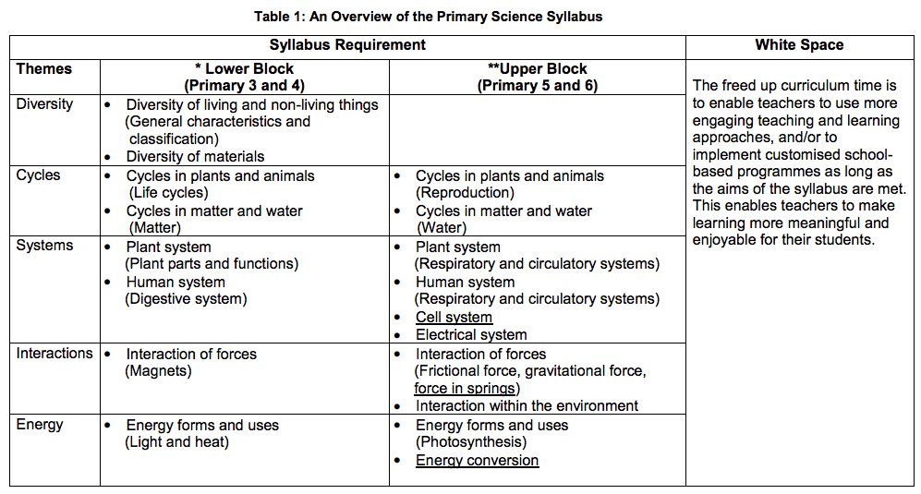
Title Section Here
SUB-TEXT HERE
SUB-TEXT HERE
In the Singaporean science curriculum, the same themes are returned to in different phases, with the concepts getting more difficult each time.
Notes:
Coherence: They specify the topics or concepts which fall within each theme, and the order in which they’re taught. These are ordered to ensure necessary prior knowledge is in place (e.g. energy forms before energy conversion), and to return to and deepen understanding of the underlying themes and their essential takeaways. This is done well in parts of the Slovakian curriculum.

Slide 14
Title Section Here
SUB-TEXT HERE
SUB-TEXT HERE
In the Singaporean science curriculum, there are only 4-5 topics a year.
Notes:
Focus: Only 4-5 topics a year (similar to Slovak primary).
Teacher autonomy in content choice comes from the remaining ‘white space’.
Is there any space left in Slovakian curriculum?

Slide 15
Title Section Here
SUB-TEXT HERE
SUB-TEXT HERE
SUB-TEXT HERE
The content is focused, and brings together the:
knowledge, related skills and values/attitudes.
Notes:
Everything else organised around this core structure to make it simpler for teachers and students.

Slide 16
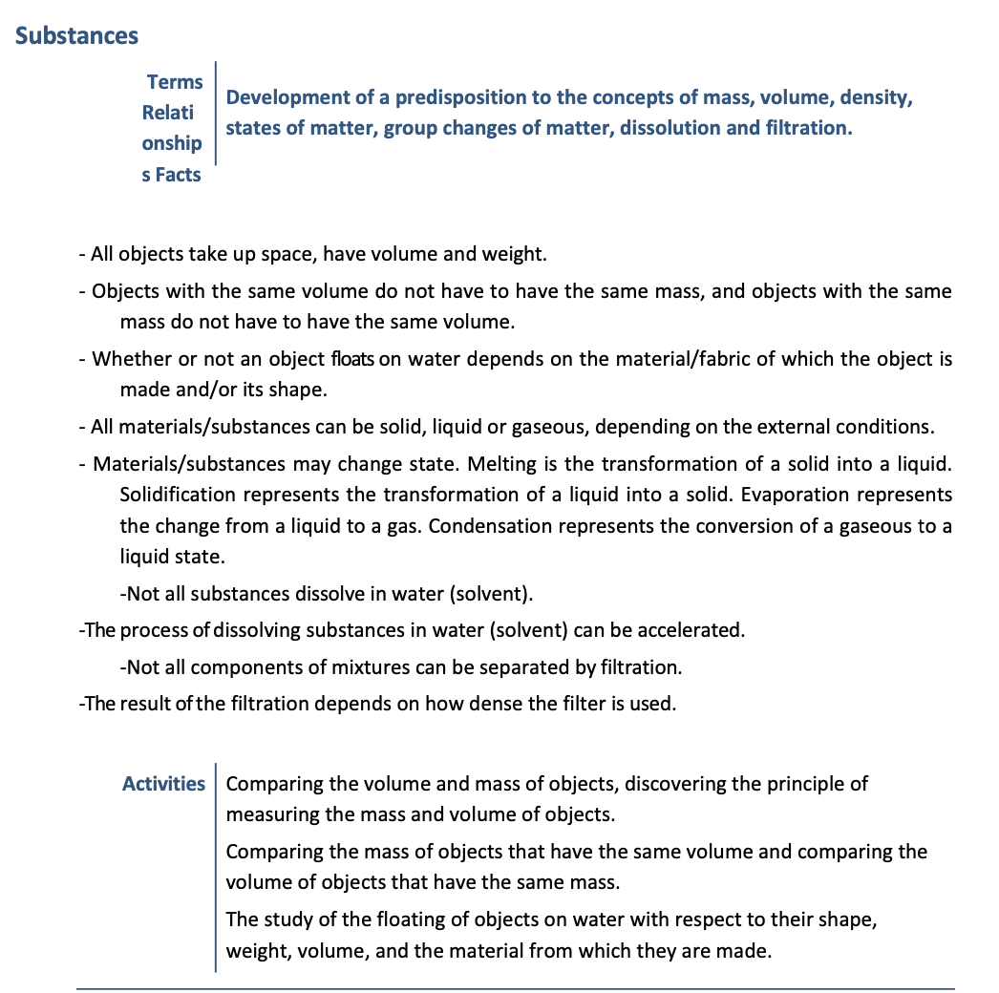
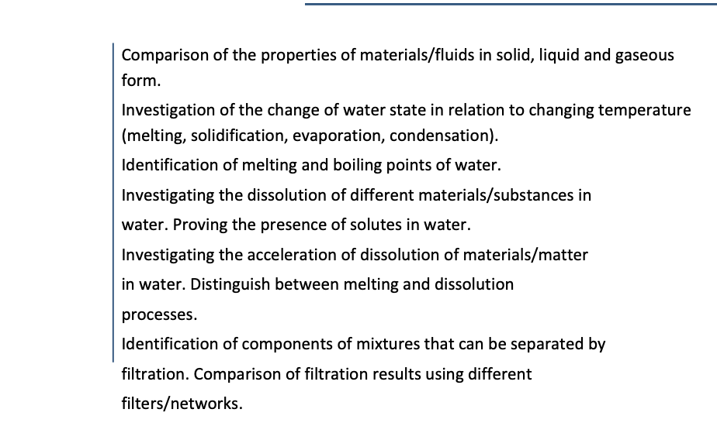
There appears to be more content in the Slovakian curriculum.

